Slide 1

Host a HirePaths Career Hunt in Your Community!

Slide 2
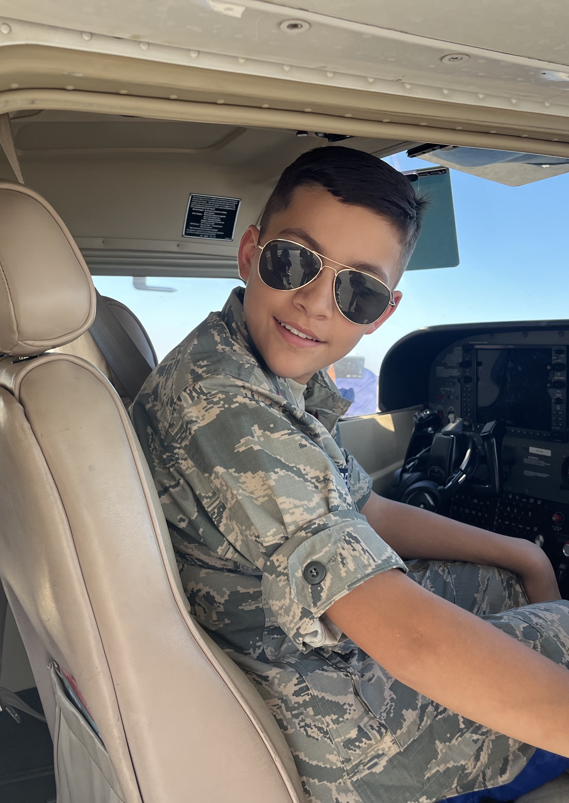
What is HirePaths?
HirePaths connects the next generation to high-demand jobs in Kansas. We inform kids and their parents about Kansas careers through:
A statewide media campaign and robust website (HirePaths.com)
Live events for kids and teens
Free resources for parents, educators, kids and youth organizations

Slide 3
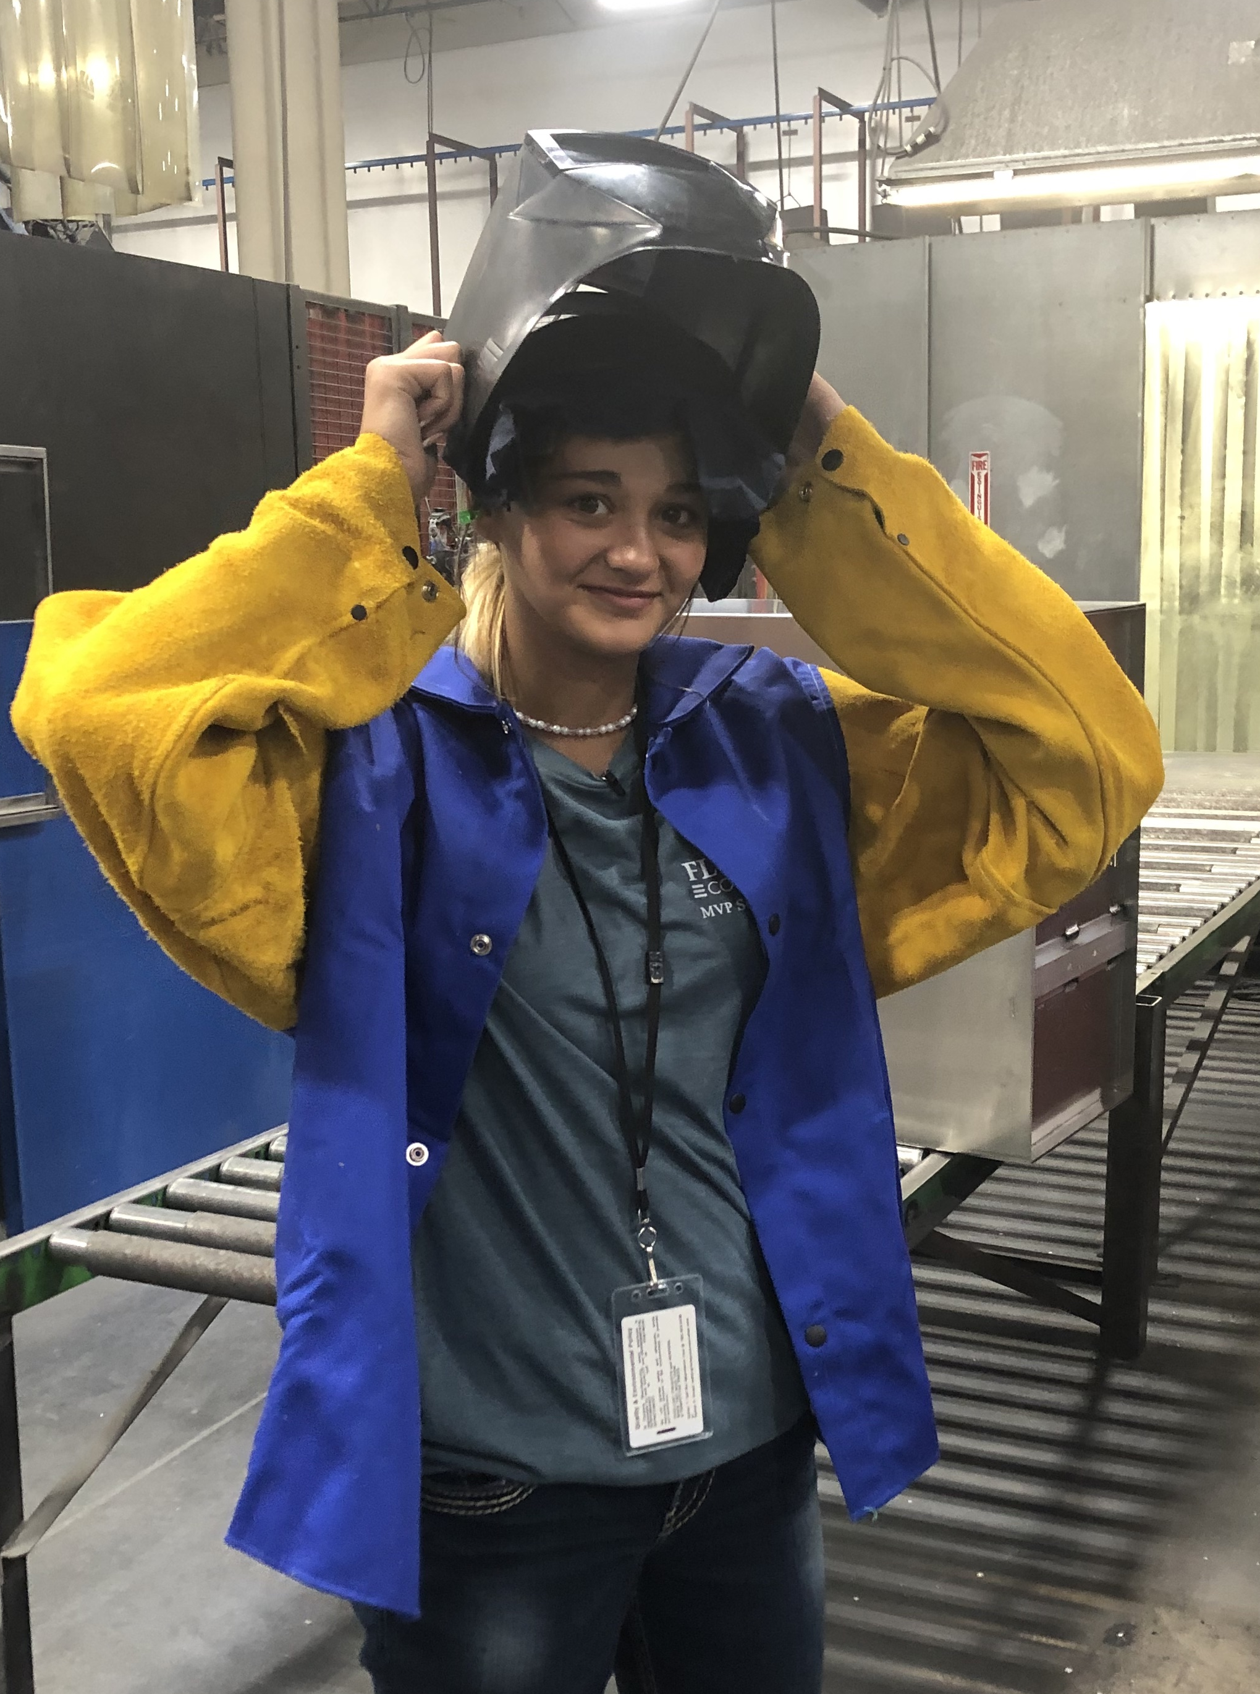
HirePaths Key Messages
There are a variety of paths to a successful career: On-the-job training, apprenticeships, tech and community colleges and colleges/universities.
You can start a well-paying, in-demand career without first earning a college degree.
A young person going straight to work or to a tech/community college is a success! Kansas needs people pursuing all paths.

Slide 4

Primary Kansas Industries Highlighted

Slide 5
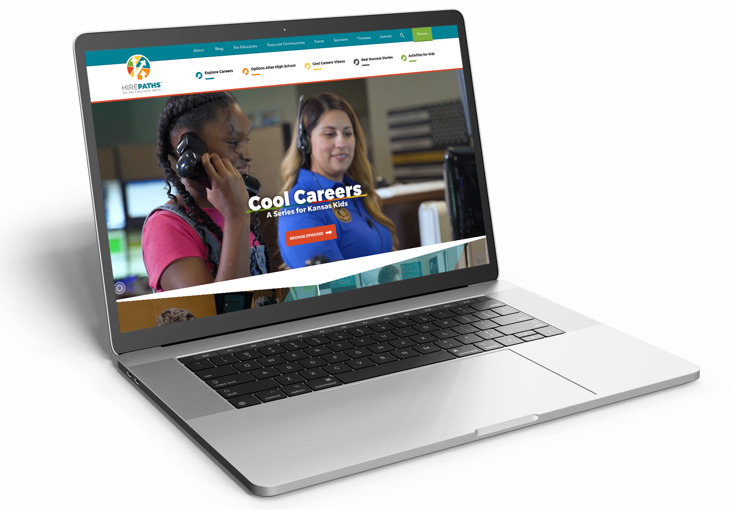

Four Ways Students Learn with HirePaths
1
2
Online Career Exploration Tools
Content published on HirePaths.com and five social media channels
Cool Careers Series
Short videos hosted by Kansas kids featuring exciting, high-demand careers (shown on YouTube, HirePaths.com and Kansas PBS)

Slide 6
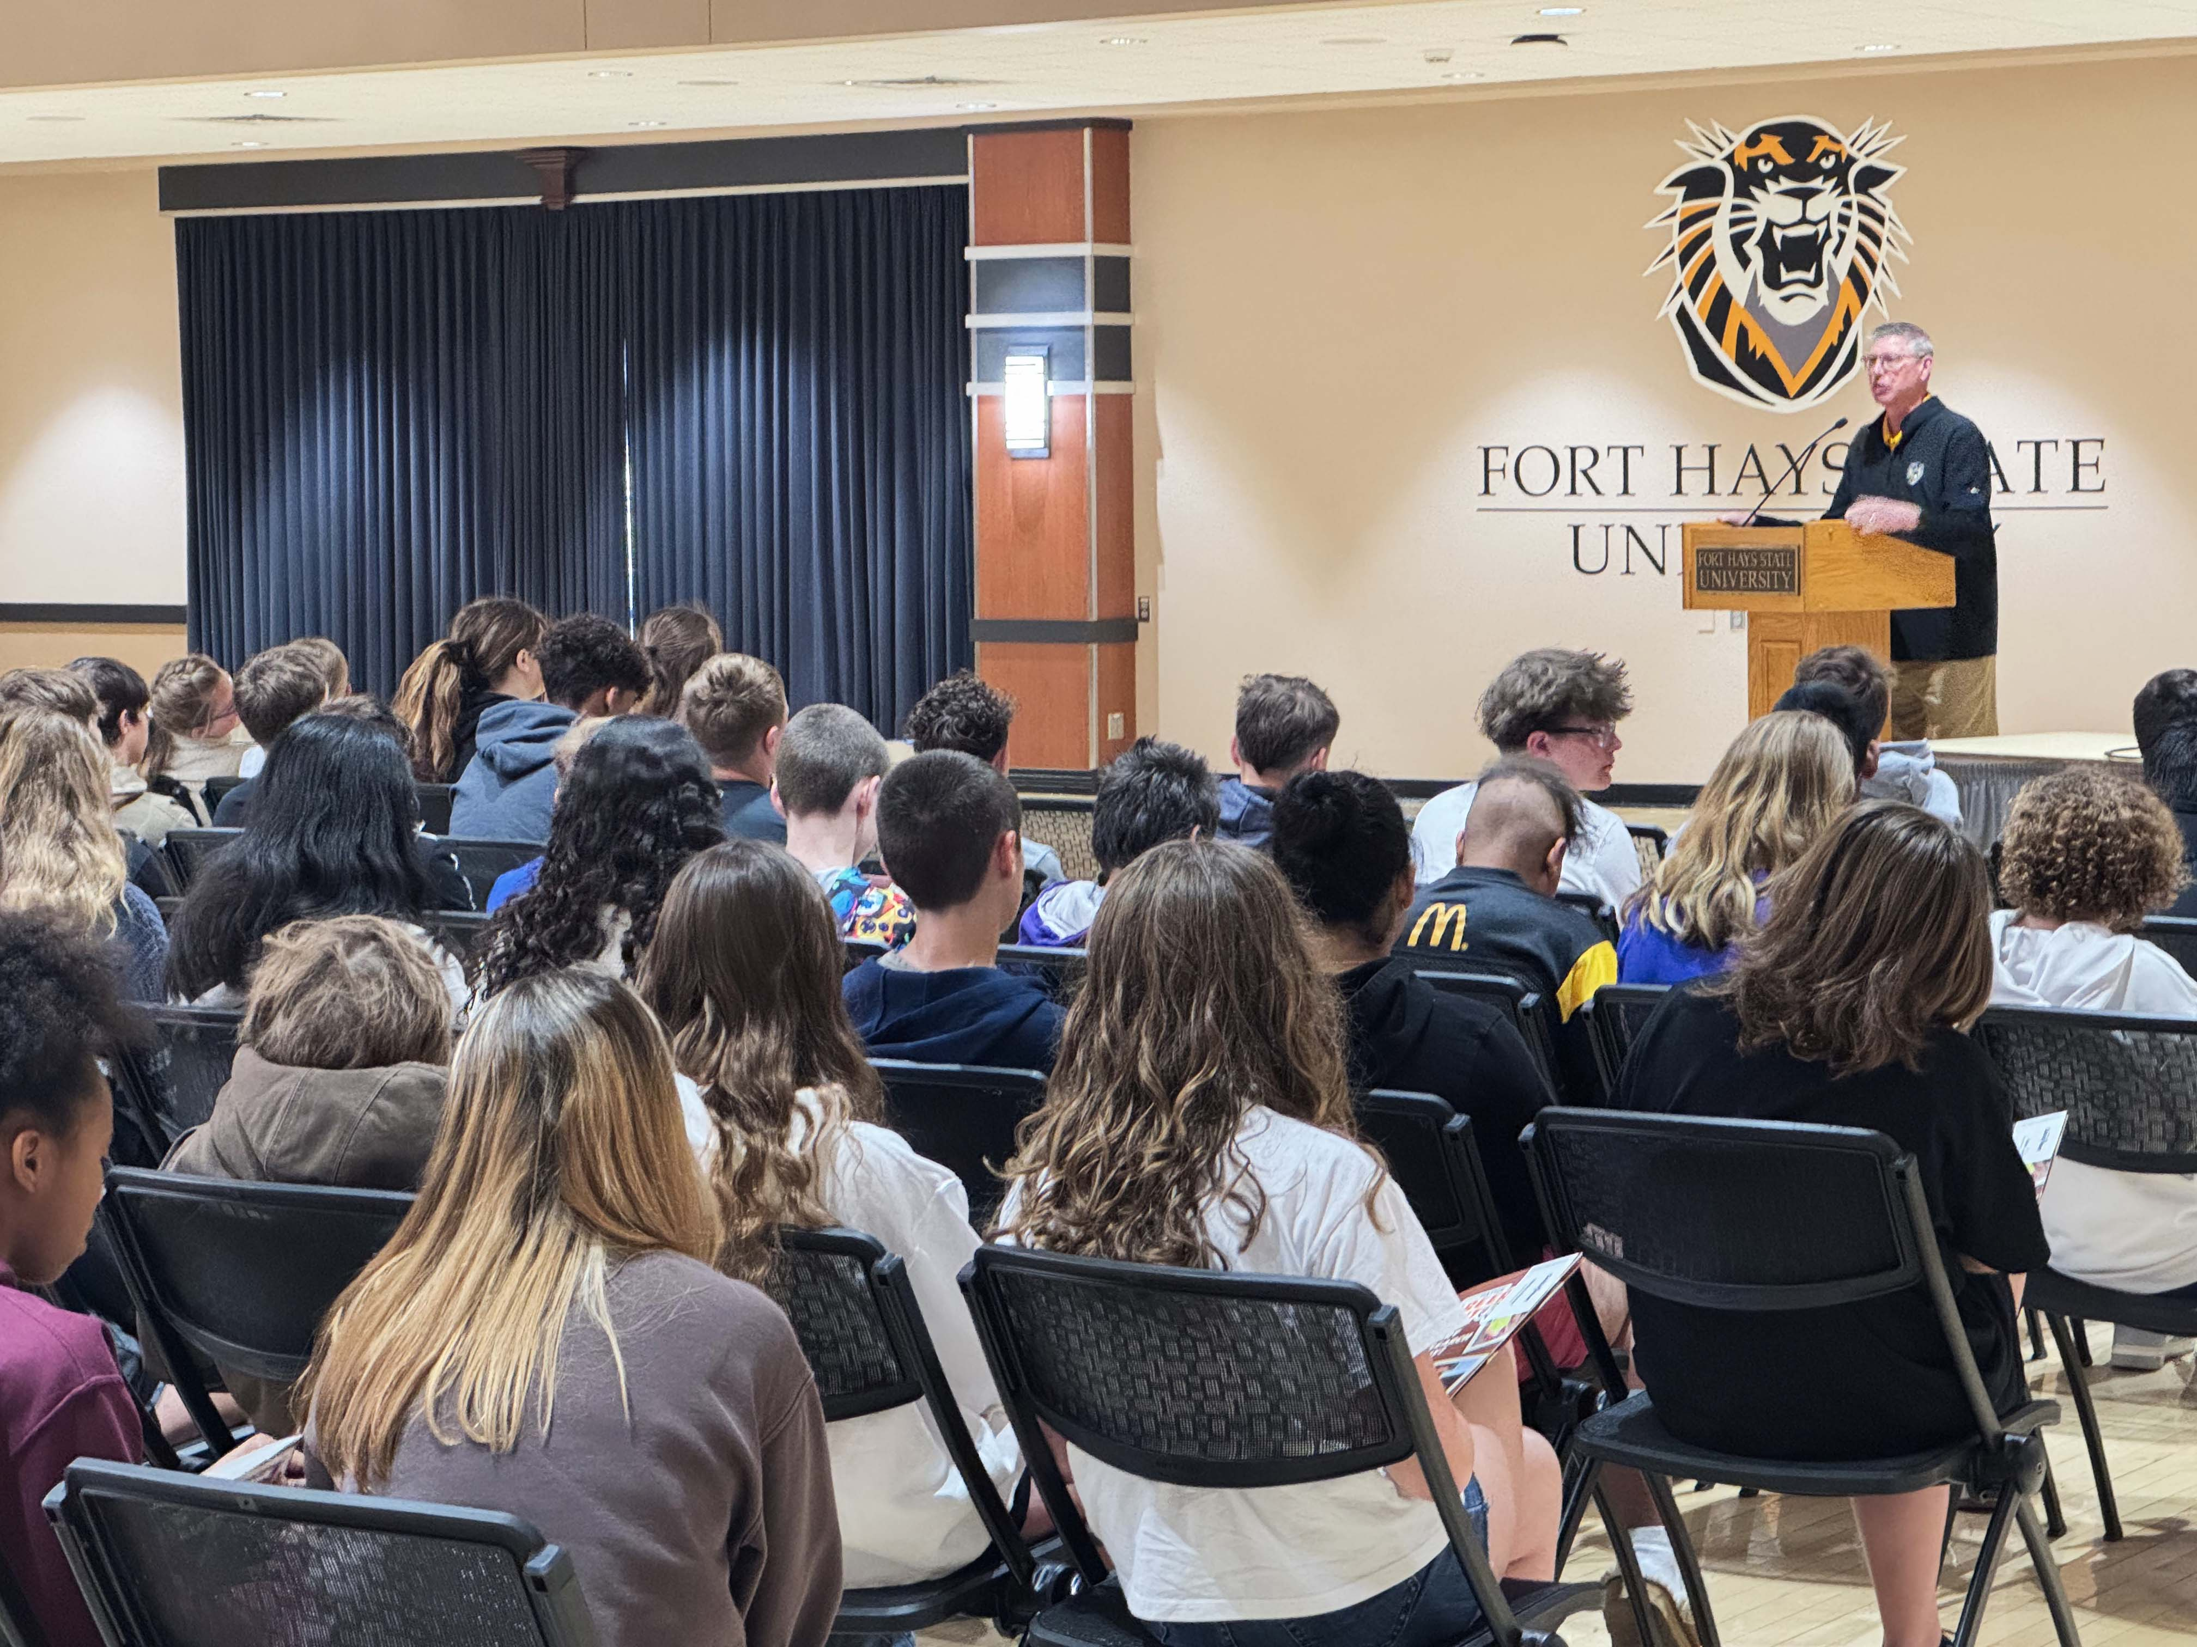

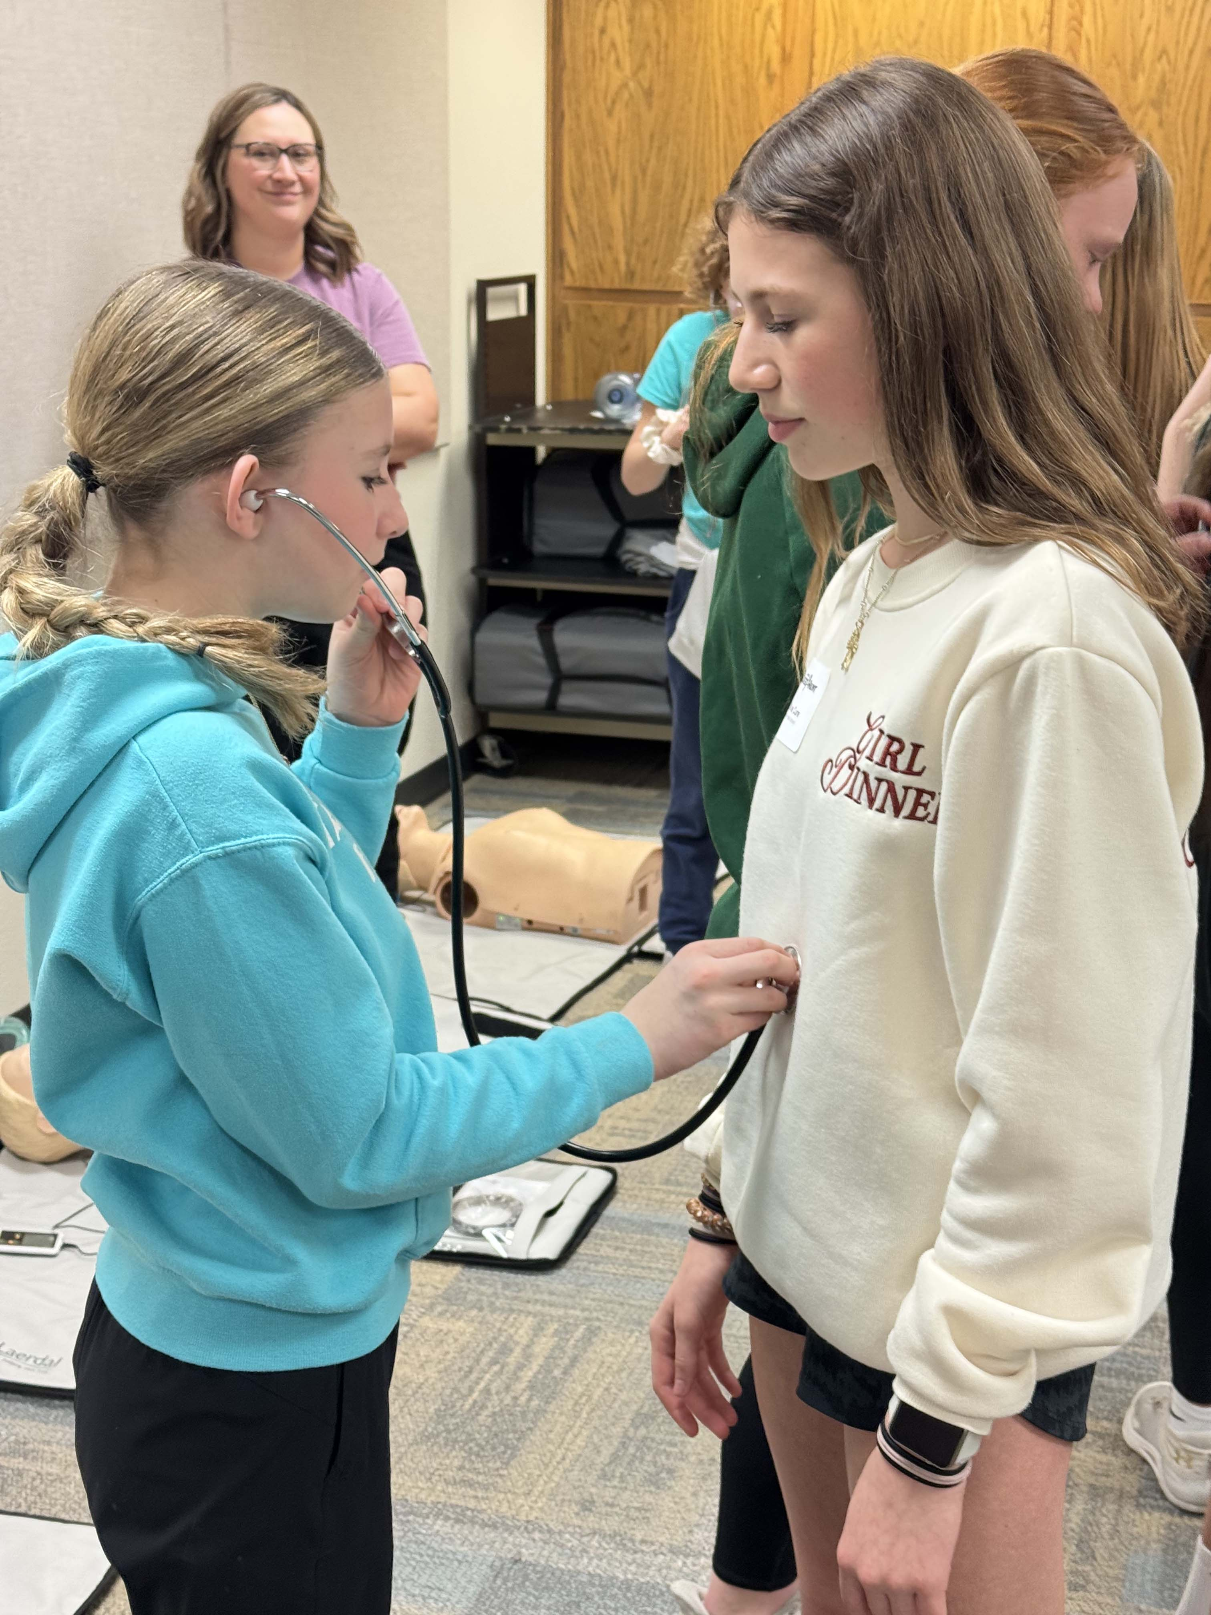
Four Ways Students Learn with HirePaths
3
4
Career Hunt Events
Live, half-day events for students to learn about careers in your region
Student-Generated Content
Real, work-based learning opportunities for students

Slide 7

Let’s Plan an Event Together!

Slide 8
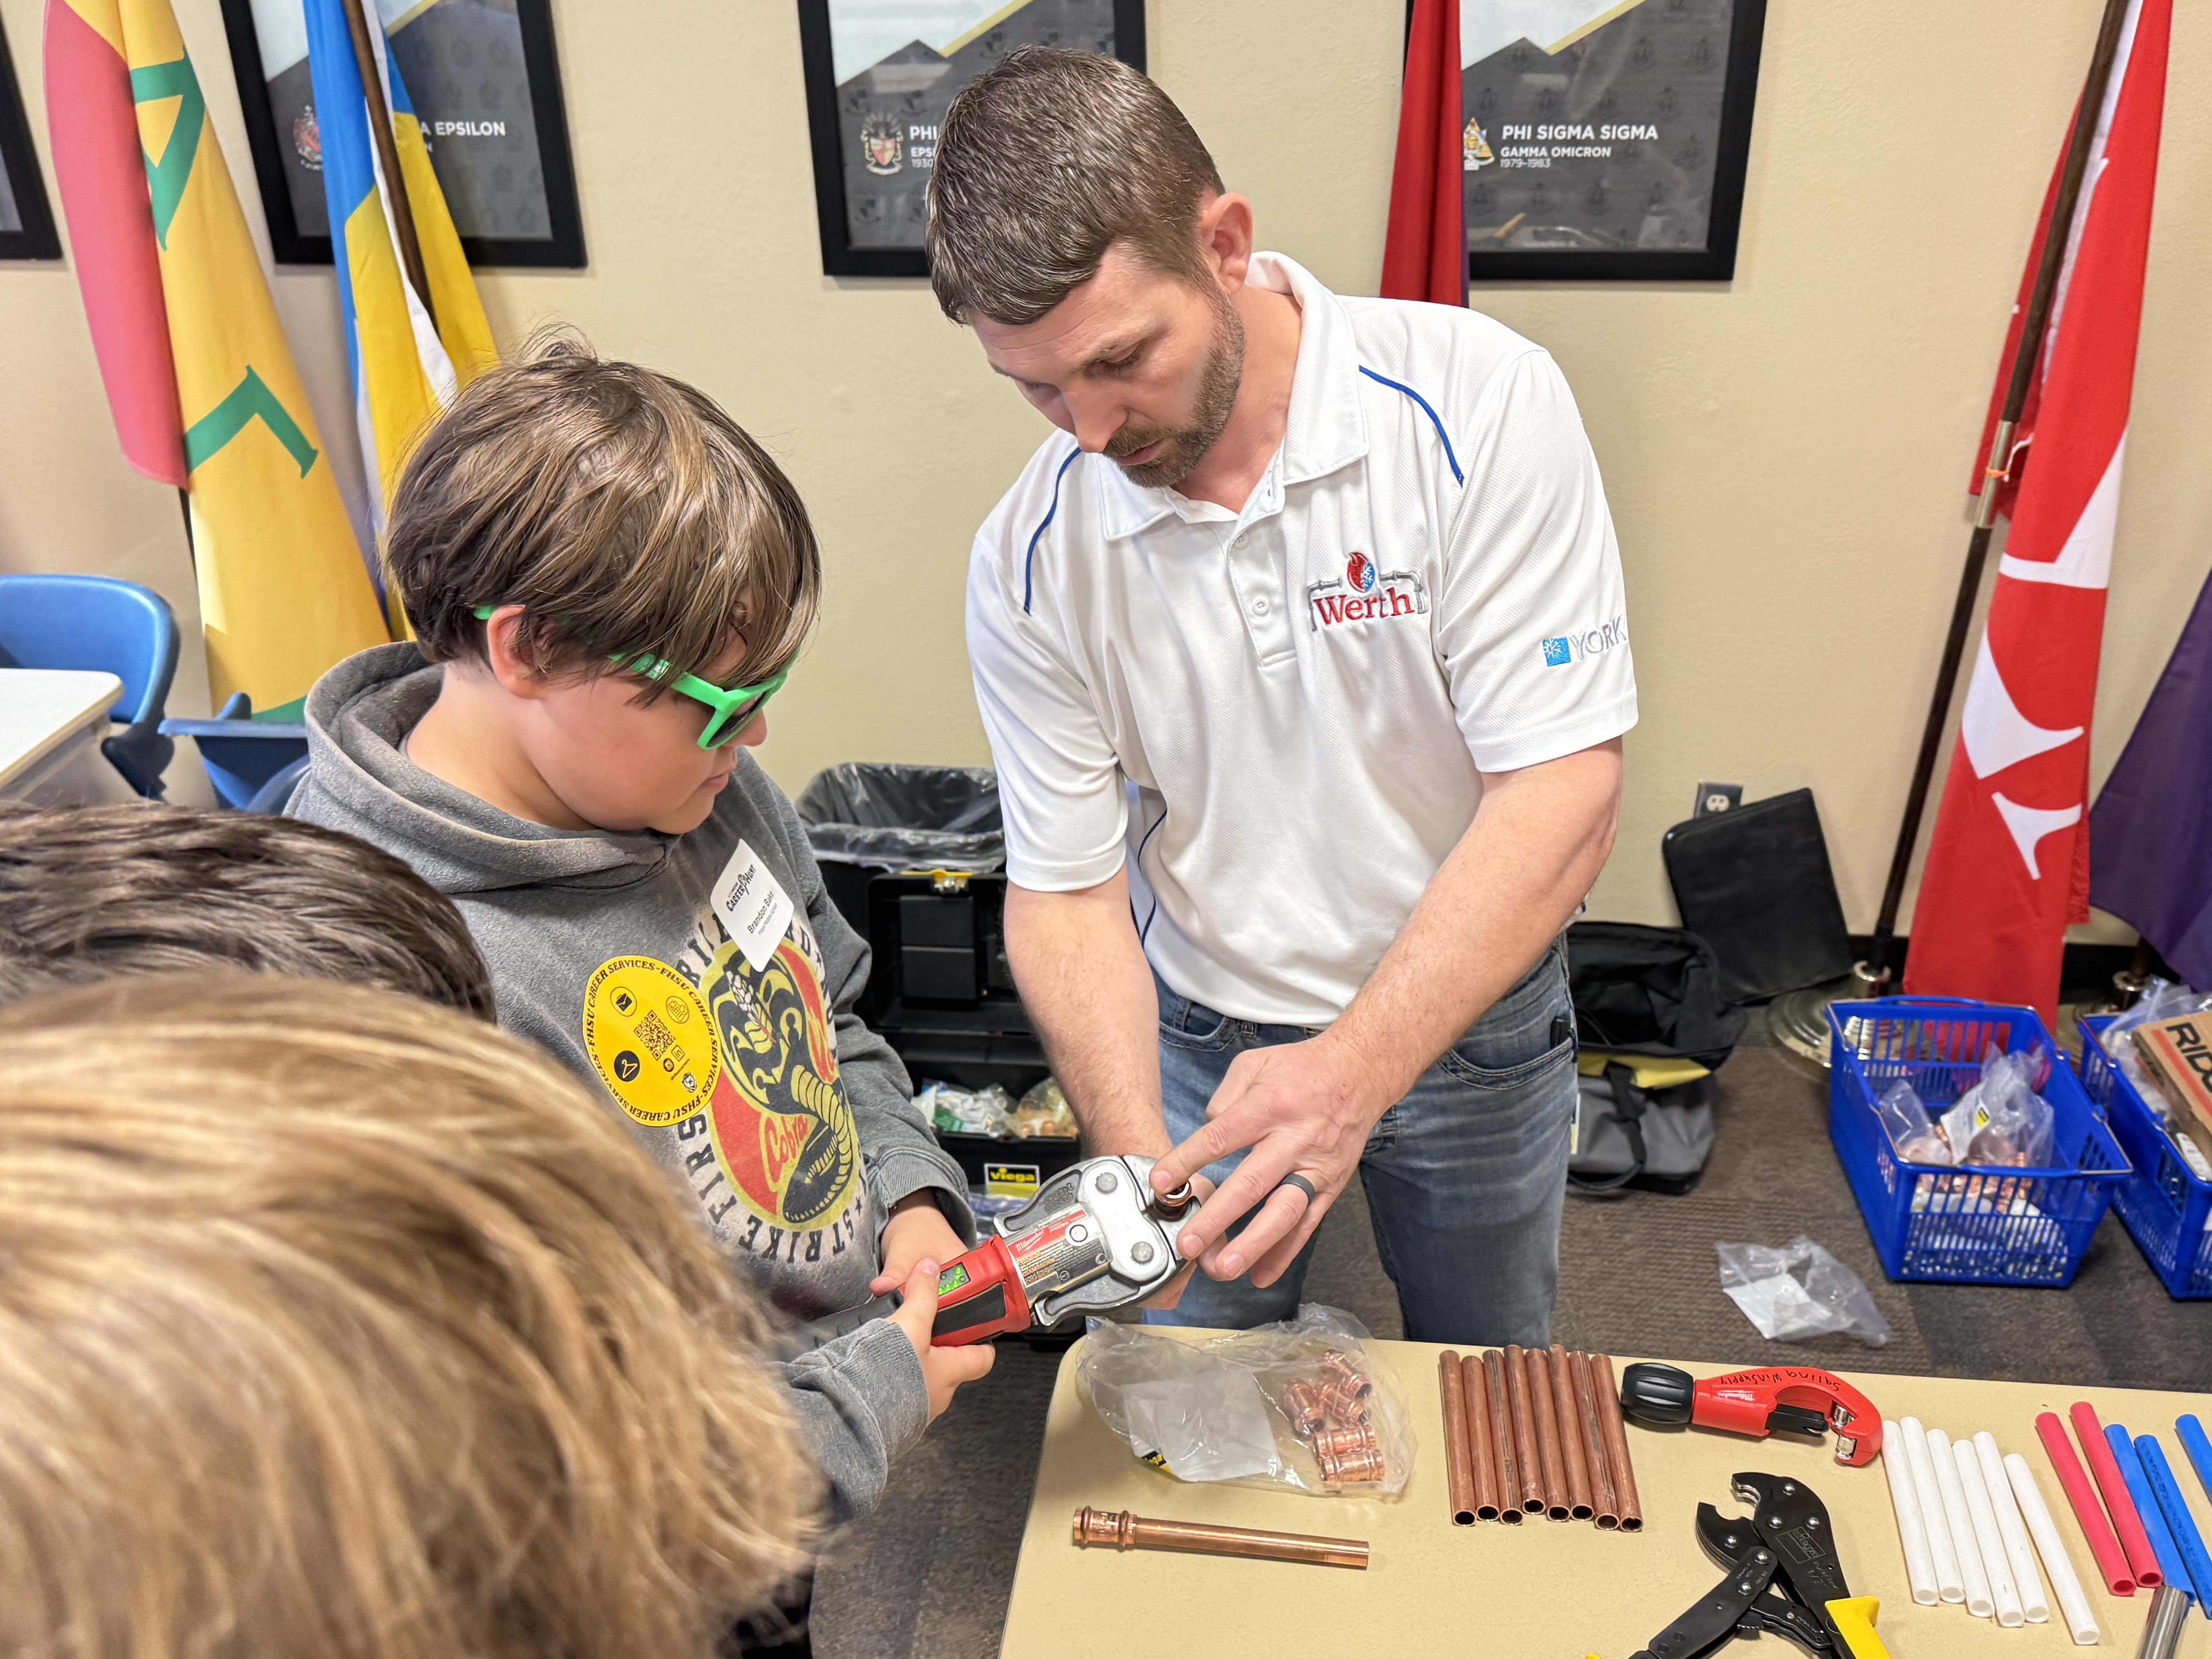
Career Hunts
Half-day events that allow students to learn about high-demand careers in your area they can pursue later in life.
Adaptable for most middle grades (fifth through ninth).
Events accommodate approximately 350 students, depending on facility size and number of industry groups represented.
All signage, handouts and marketing tools provided. Online registration tools (handled by HirePaths) allow students to customize their experience based on interests.

Slide 9
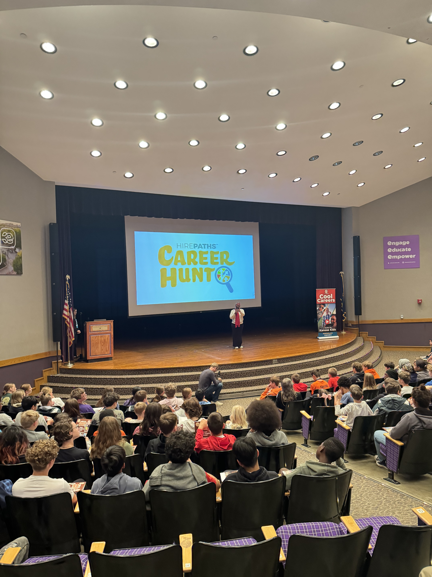
Who Would Want to Host a Career Hunt?
Community partners interested in building their future workforce pipeline can work together to plan a Career Hunt.
We suggest forming a local planning committee from partners such as:
Schools (public or private/homeschool)
Chambers of commerce
Economic development organizations
Two-year and four-year colleges
Workforce centers

Slide 10
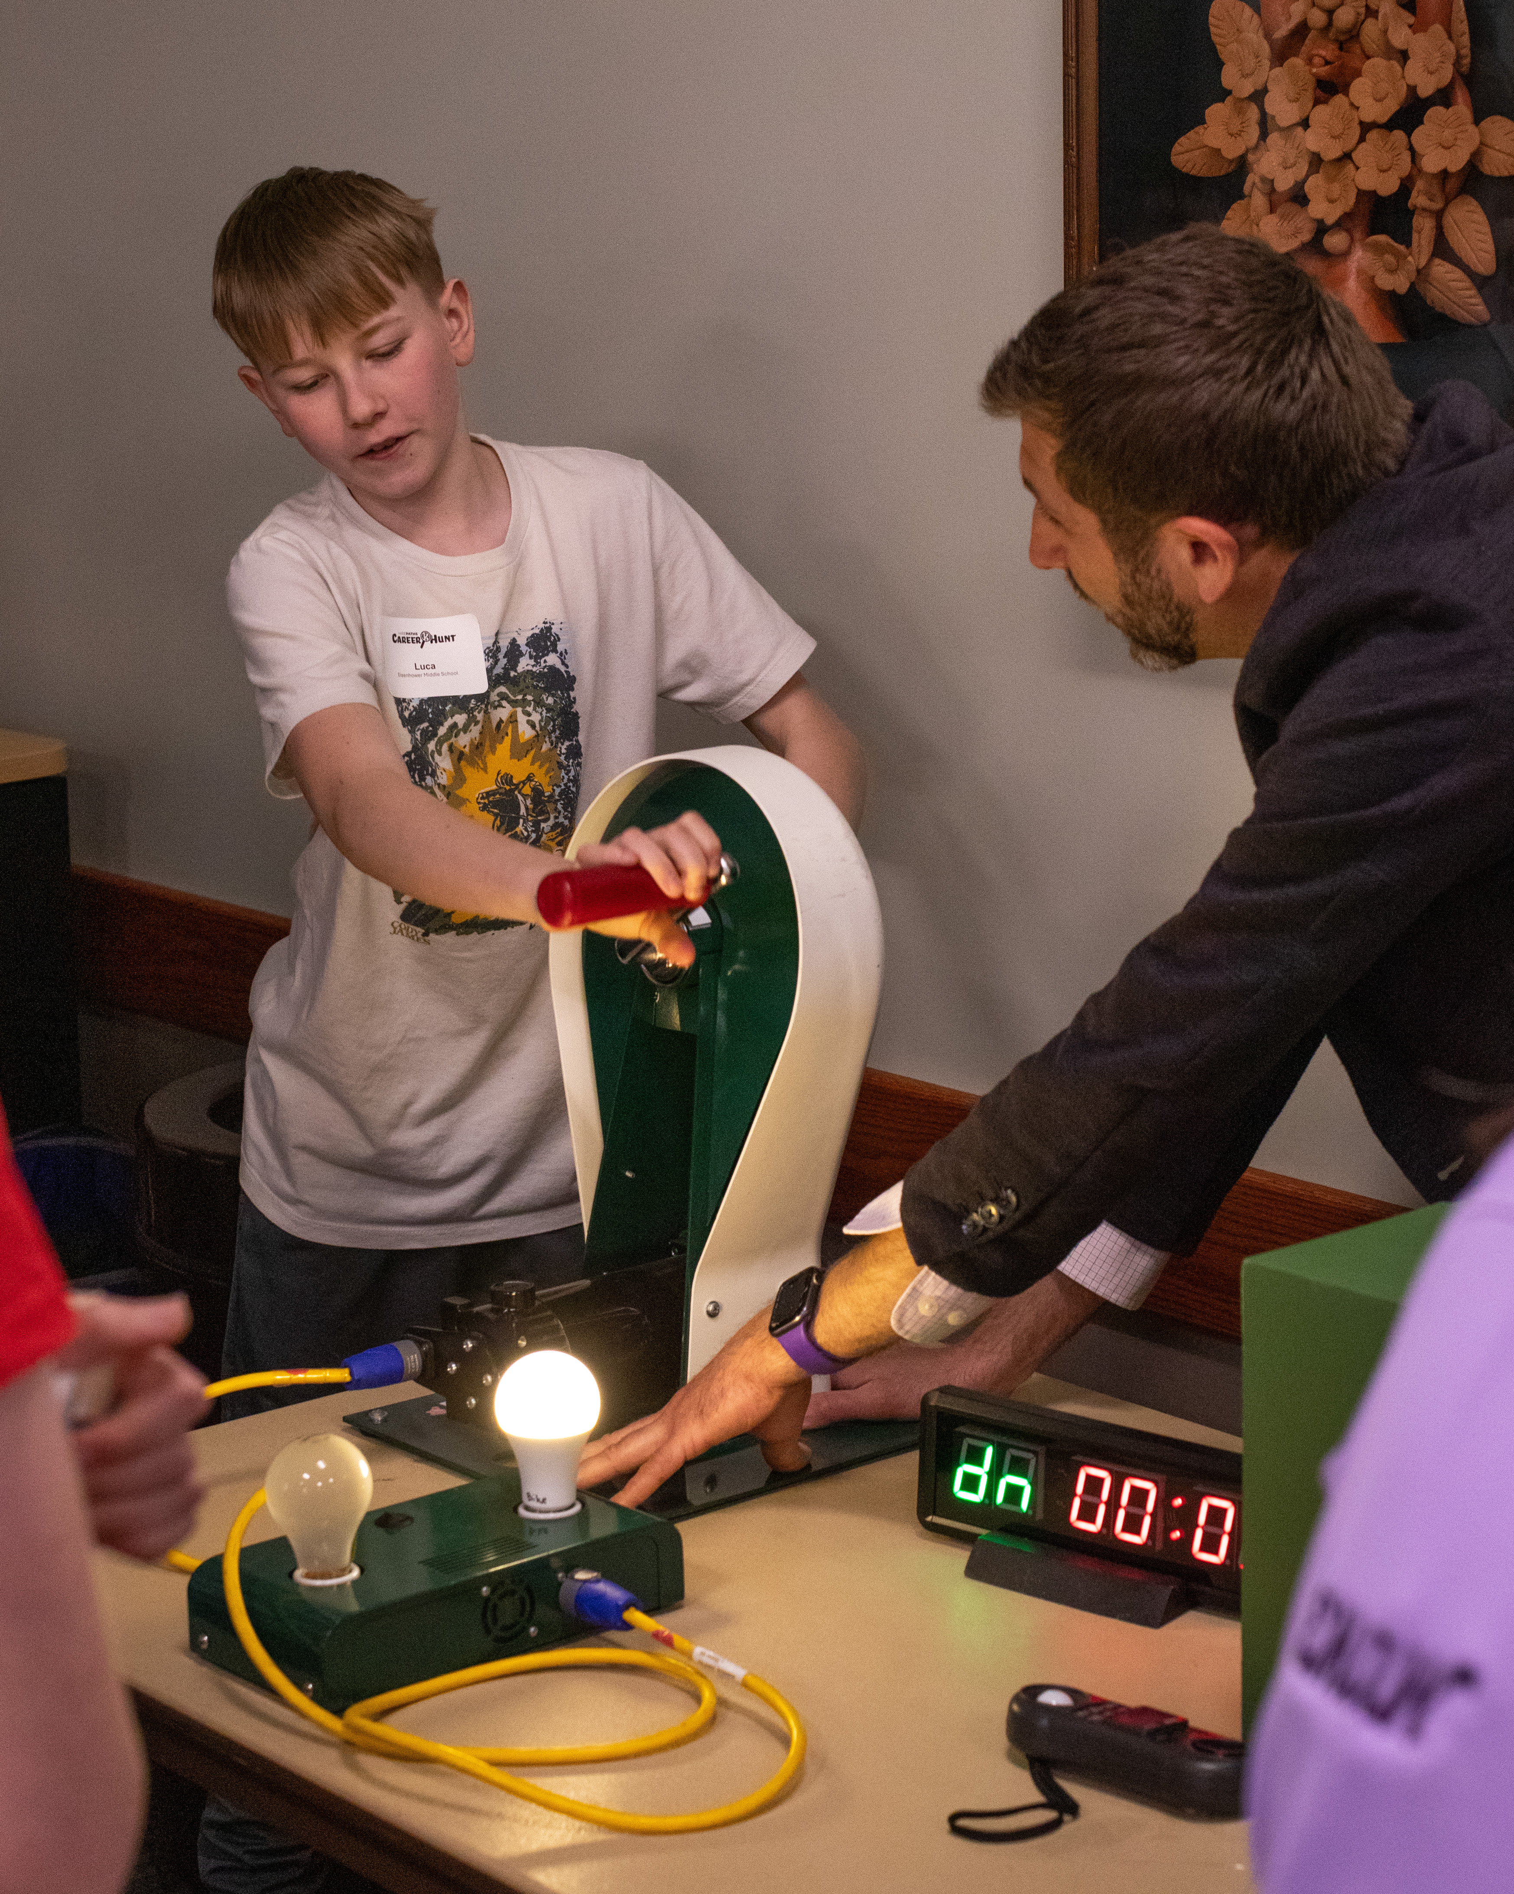
Sample Schedule of Events
9:15 — Welcome Session
9:45 — Transition to Session One
9:55 — Breakout One
10:40 — Transition to Session Two (restroom/snack break)
10:50 — Breakout Two
11:35 — Transition to Session Three (restroom/snack break)
11:45 — Breakout Three
12:30 — Load buses to return to school

Slide 11
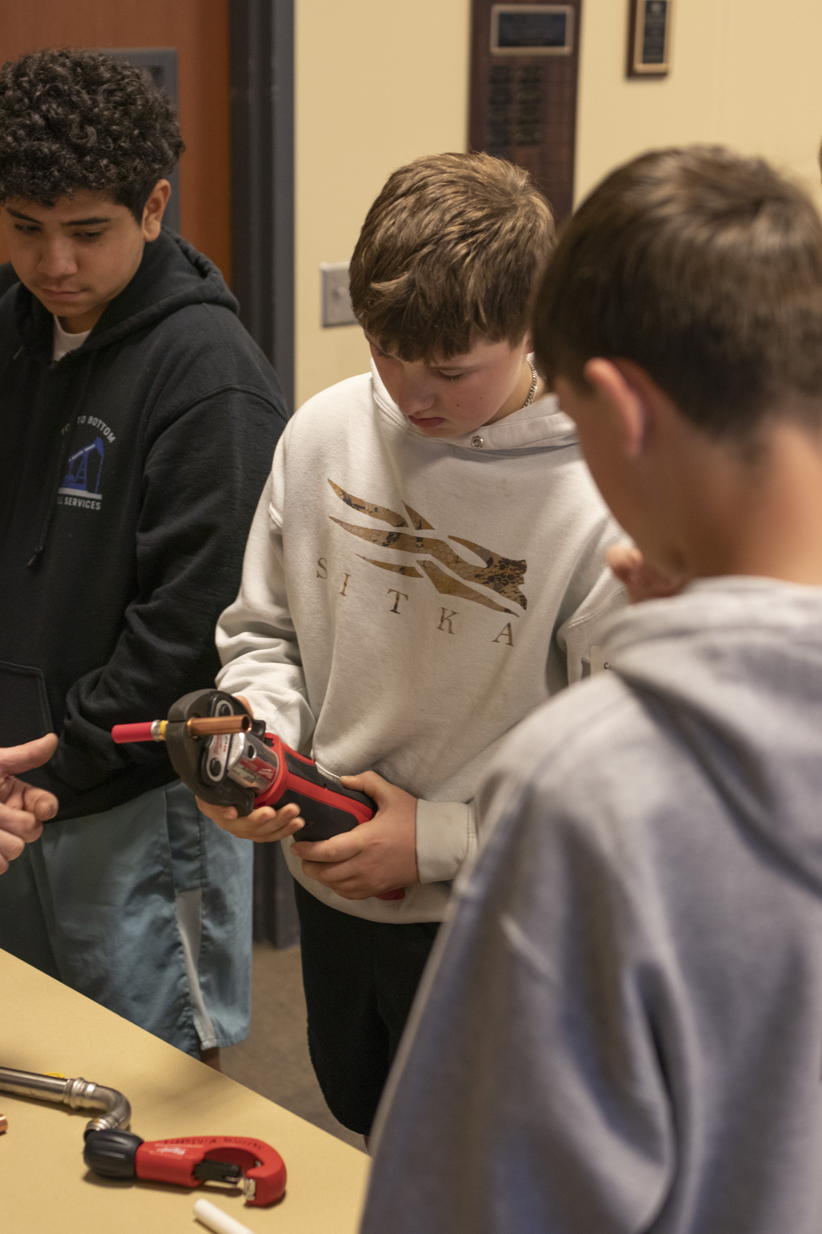
Outline of Breakout Sessions
Each session will feature two or three speakers from your local community working in each industry.
Welcome: Moderator will kick off the session. (1 min)
Introductions: Speakers will introduce themselves, who they work for, what their company makes/does, and who their clients are. (4 min)
Jobs in Your Company: Speakers will have 2-3 more minutes to talk about various careers at their company and what kind of training those roles require. (6-9 min)
Speaker-Led Activity/Demonstration: (30-35 minutes TOTAL)
Set up activity stations and let kids rotate between stations, OR
Divide time between speakers and lead activities with the entire group (up to 30 students).
Notes:
Don’t talk about yourself very much; mostly about your job and what you do in your job!

Slide 12
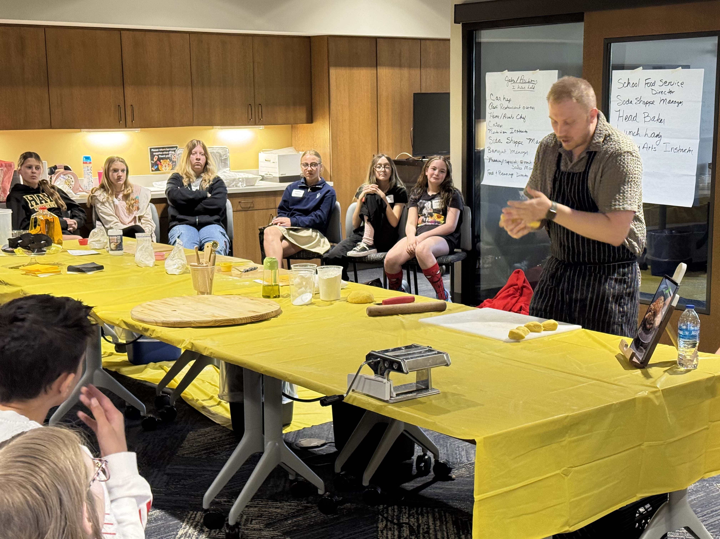
What Are the Committee’s Responsibilities?
Your group is responsible for:
Finding a facility that can host the event. You’ll need a large meeting space and 10-12 breakout rooms for each industry group. A college or school will work unless the event interrupts the learning for other students not participating in the event.
Deciding which of the 12 HirePaths industry groups fit your community. Make adjustments to fit your local workforce needs.

Slide 13
What Are the Committee’s Responsibilities?
Your group is responsible for:
Finding someone “famous” to serve as a welcome speaker. They’ll speak for 10-15 minutes to set the tone and get kids excited for their day.
Recruiting panels of two or three speakers who work in each industry to facilitate breakout sessions. These should be as active as possible, with minimal time of adults talking “at” students. The students should be up and moving around, engaging in hands-on learning and activities.

Slide 14
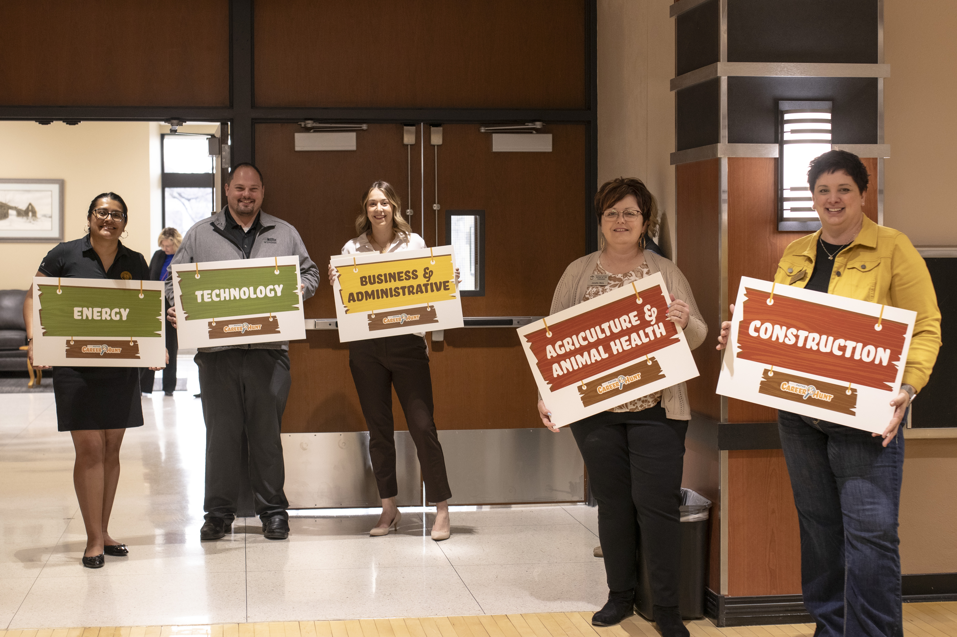
What Are the Committee’s Responsibilities?
Your group is responsible for:
Recruiting some volunteers to help! You’ll need a room moderator for each industry session and some additional volunteers (think parents or retirees) who can help kids find their way between breakout sessions.

Slide 15
What Does HirePaths Provide?
Our team provides the event’s structure, online enrollment tool, marketing and communications for your event, as well as help with local planning.
Facilitation of planning meetings for committee
Agenda for the event
Training materials for speakers
Collaboration with school contacts to handle online student registration
Scripts for recruitment emails and room moderators
List of activity ideas and a video outlining expectations for speakers
Event signage and student lanyards with schedules
Background materials and student reflection worksheets for schools
A HirePaths team member in attendance at your event to help ensure everything runs smoothly (if requested; additional travel costs will apply)
Event evaluation and report for the committee

Slide 16
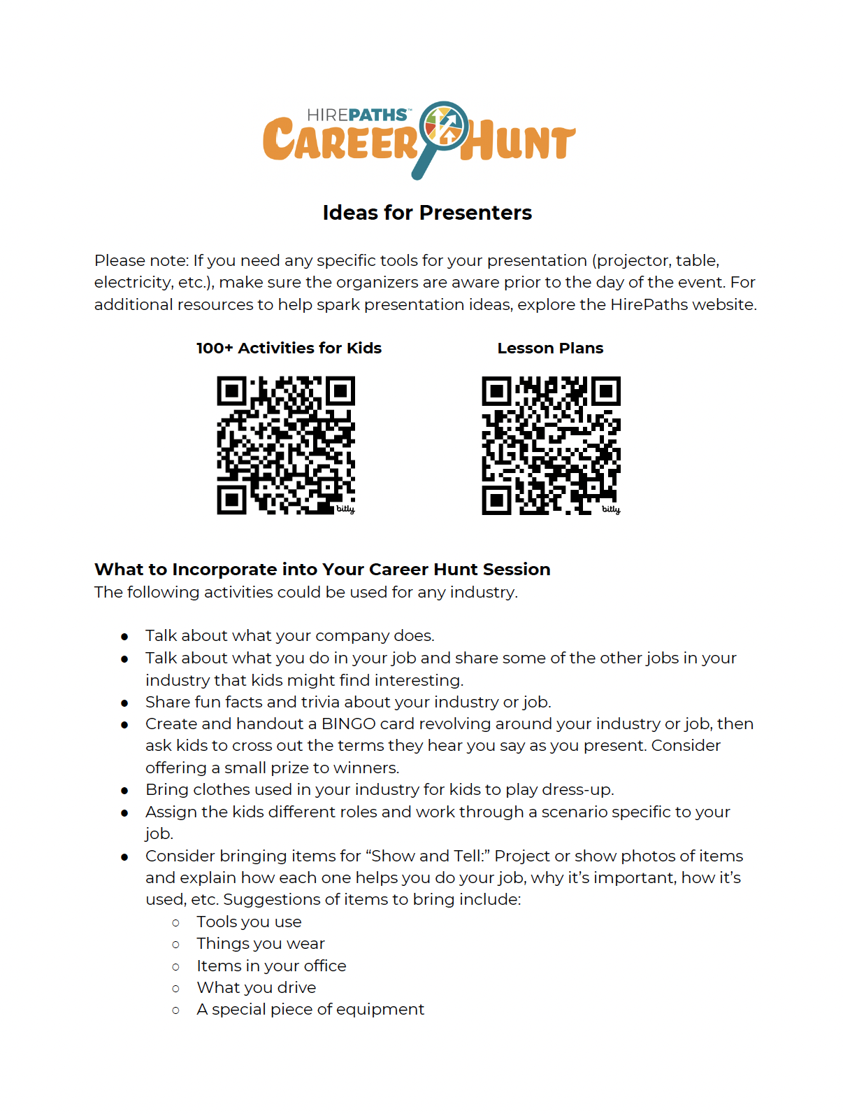
Training Speakers
HirePaths provides speakers with a list of ideas they can use to brainstorm their activities, as well as a video that provides an overview of the event and expectations of the day.
We also recommend connecting the panel members several weeks ahead of the event so they can coordinate their session planning and activities.
The more hands-on each session is, the better it will be received!

Slide 17
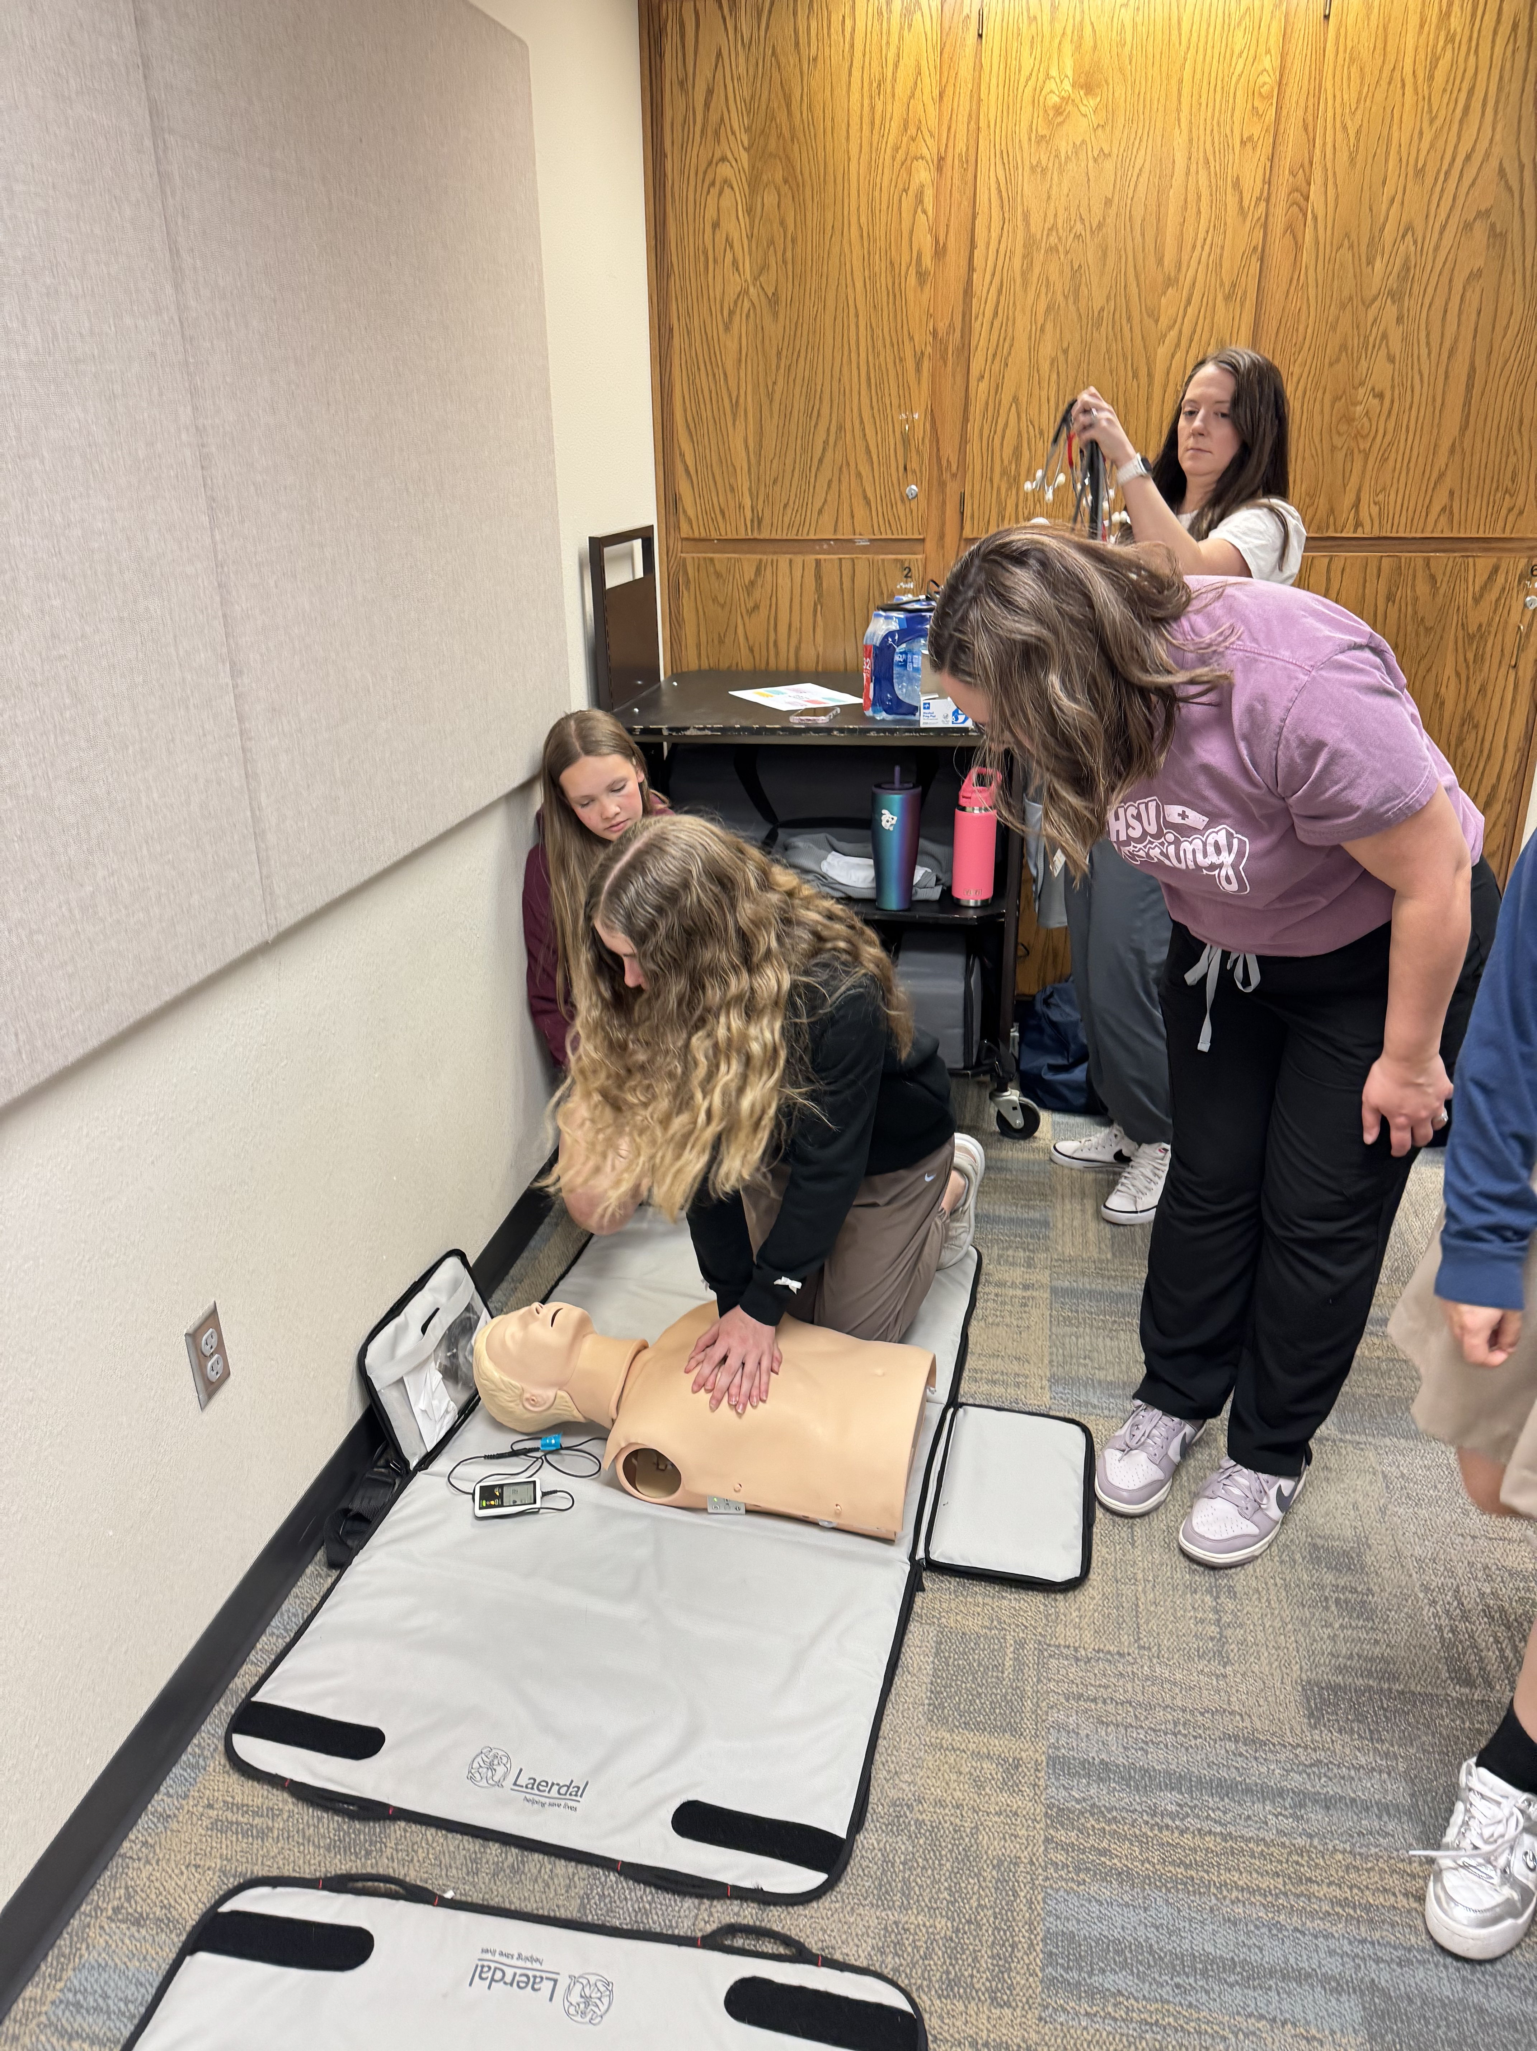
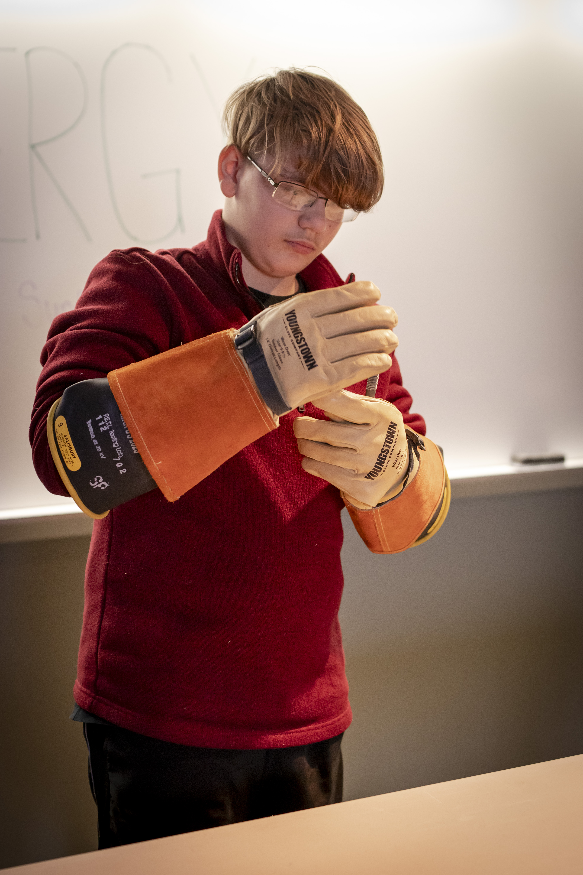
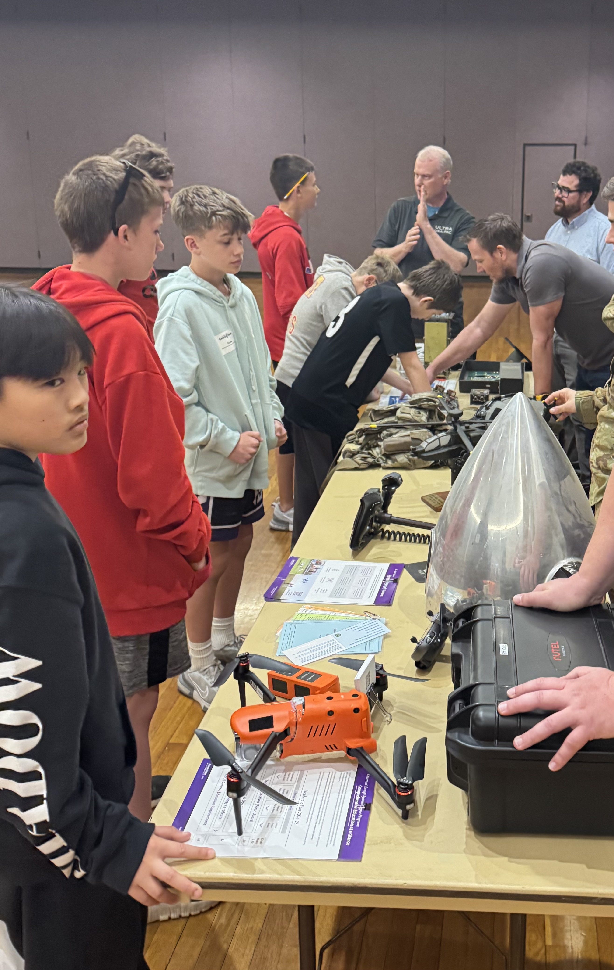
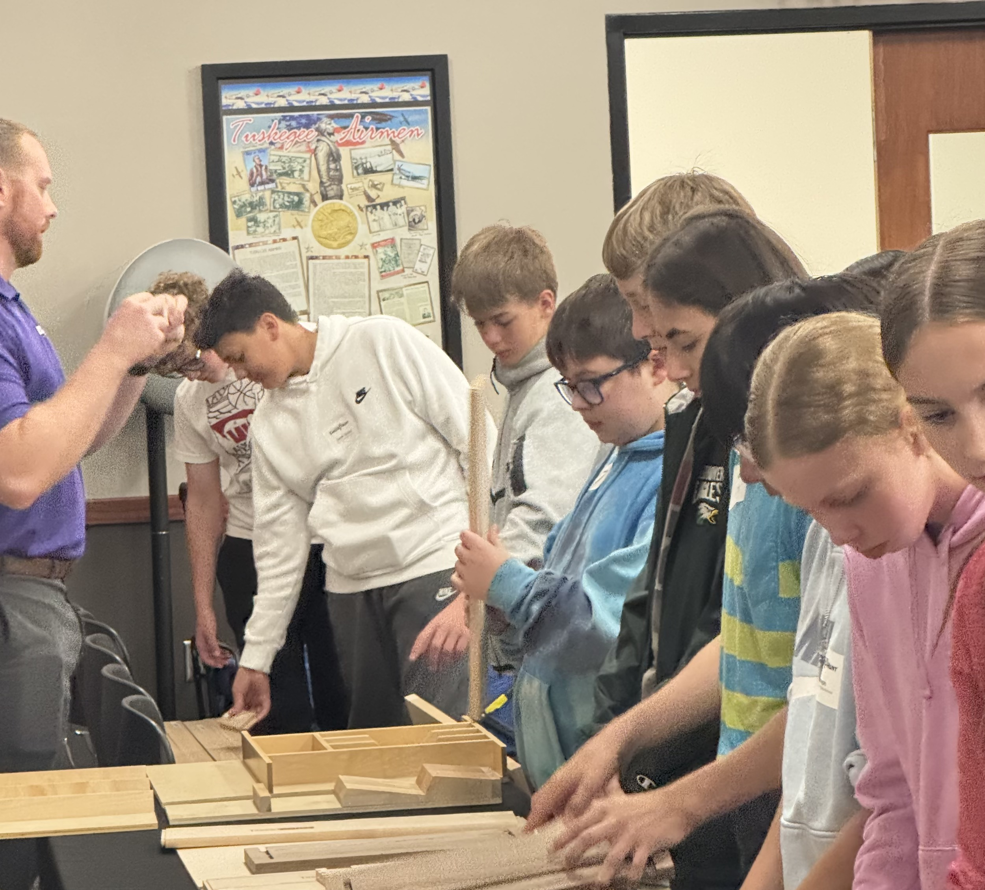

Slide 18
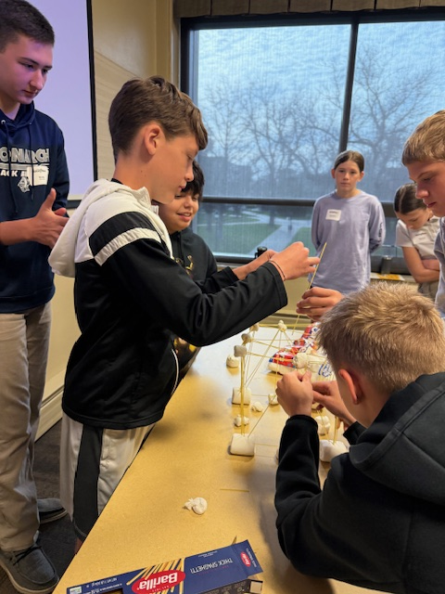
Program Costs
Career Hunts are FREE to host and for companies to participate.
HirePaths will apply for local grants of $10,000 to help cover our expenses, as well as sell statewide sponsorships to underwrite our program.
Hosting partners are welcome to sell sponsorships, if needed, to cover local costs.
Historically, local committees have found partners to donate the event space, snacks/drinks and student busing costs.
If you’d like a HirePaths team member to attend your event, we will ask the community to cover travel costs and hotel expenses, if needed.

Slide 19
Let’s Plan an Event in 2025-26!
Contact: Kristin Brighton, kristin@newbostoncreative.com

